Slide 1
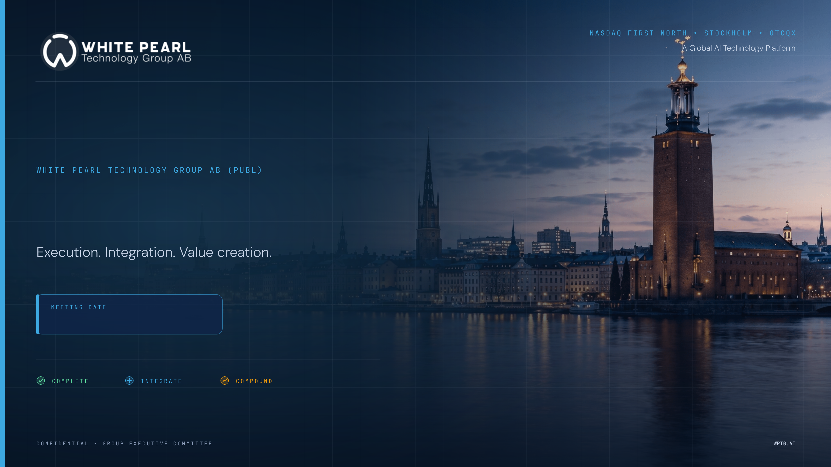
WPTG Investor Briefing.
24 August 2026
Notes:
[Sources]
- User-supplied WPTG Corporate Profile deck, July 2026
- WPTG Visual Kit 2026

Slide 2

NASDAQ FIRST NORTH · STOCKHOLM · OTCQX
STRATEGIC DIRECTION
WPTG is becoming an AI-first technology platform.
A sharper operating model connects infrastructure, software, managed services and applied AI.
TODAY
STRATEGIC SHIFT
FUTURE STATE
Profitable listed technology group
Build the platform layer
AI-first technology platform
• Digital transformation and IT services
• Enterprise systems, cloud and cybersecurity
• Growing recurring revenue and IP mix
• AI-first operating model
• Institutionalisation and governance
• Productisation and recurring revenue
• Infrastructure + MLOps + AI applications
• Enterprise, industry and public-sector AI
• Higher-quality revenue and positioning
WPTG AI FACTORY
01
Strategy & Advisory
02
Data Foundation
03
AI Infrastructure
04
AiQu & MLOps
05
Applied AI Platforms
06
Managed Outcomes
A GLOBAL AI TECHNOLOGY PLATFORM · WPTG.AI
Notes:
[Sources]
- User-supplied WPTG Corporate Profile deck, July 2026
- WPTG Visual Kit 2026

Slide 3
INVESTOR BRIEFING • AUG 2026
Nasdaq First North · Stockholm · OTCQX
H1 2026 RESULTS
Strong H1 performance.
Balance-sheet movements need context.
The message is not defensive: explain the main movements clearly, show the business remains profitable, and anchor the discussion in cash conversion.
RESULTS CONTEXT
Revenue
EBITDA
Net profit
Reported H1 performance is strong. The market question is working capital and balance-sheet interpretation.
SEK 303.8m
SEK 53.6m
SEK 47.8m
Up 30.6%
Up 44.5%
Up 30.2%
ISSUE 1
ISSUE 2
ISSUE 3
Trade receivables and cash conversion.
Intangibles and platform investment.
Liquidity, payables and acquisition effects.
INVESTOR TAKEAWAY: Clarify the three balance-sheet questions before investors ask them.
A GLOBAL AI TECHNOLOGY PLATFORM • WPTG.AI
01 / 07

Slide 4
INVESTOR BRIEFING • AUG 2026
Nasdaq First North · Stockholm · OTCQX
TRADE & OTHER RECEIVABLES
June receivables are elevated as the Group scales — but the trend is explainable.
The relevant comparison is June-to-June, not December-to-June in isolation. The full balance-sheet line includes prepaids and other receivables, while DSO is based on trade receivables only.
2024
2025
2026
H1 revenue
H1 revenue
H1 revenue
SEK 139.5m
SEK 232.6m
SEK 303.8m
→
→
Trade & other receivables
Trade & other receivables
Trade & other receivables
SEK 86.9m
SEK 102.3m
SEK 146.4m
62.3% of H1 revenue
44.0% of H1 revenue
48.2% of H1 revenue
KEY READ
Revenue has more than doubled since H1 2024 (+118%), while trade & other receivables increased by roughly +68%.
Customer trade receivables were SEK 108.9m within the SEK 146.4m total; the 24m of Receivables came in from new acquisitions.
INVESTOR TAKEAWAY: June working capital is historically elevated. In 2026, DSO improved from 79.3 days to 65.4 days year-on-year, supporting the timing/growth explanation.
A GLOBAL AI TECHNOLOGY PLATFORM • WPTG.AI
02 / 07

Slide 5
INVESTOR BRIEFING • AUG 2026
Nasdaq First North · Stockholm · OTCQX
CASH CONVERSION
Cash generation was held back by working-capital timing.
Profitability remained strong, but H1 cash flow was absorbed by June receivables, WIP/inventory and prepayments. The collection-quality message is supported by improved DSO year-on-year.
Profit for the period
WORKING-CAPITAL ABSORPTION
Net cash from operating activities
→
Trade receivables: (SEK 66.7m)
Other receivables: (SEK 8.2m)
Inventory / WIP: (SEK 16.3m)
→
SEK 47.8m
SEK 6.4m
Starting point before working-capital movements
Short-term cash conversion affected by timing
INTERPRETATION
ACTION MESSAGE
Timing/growth effect; not a collapse in operating performance.
Show collections after 30 June and prepaid-expense composition to prove normalisation.
INVESTOR TAKEAWAY: H1 cash flow should be assessed together with the balance-sheet build and acquisition activity.
A GLOBAL AI TECHNOLOGY PLATFORM • WPTG.AI
03 / 07

Slide 6
INVESTOR BRIEFING • AUG 2026
Nasdaq First North · Stockholm · OTCQX
INTANGIBLES & PLATFORM INVESTMENT
Intangibles reflect acquisitions and owned technology investment.
Additions of SEK 69.2m comprise SEK 39.7m acquisition goodwill and SEK 29.5m capitalised development, less SEK 0.5m of amortisation, disposals and translation movements.
Opening balance
Goodwill from acquisitions
Capitalised development
Closing balance
+
+
→
SEK 108.4m
SEK 39.7m
SEK 29.5m
SEK 177.1m
Intangible assets at 31 Dec 2025
New businesses consolidated in H1
Owned IP and technology investment
Intangible assets at 30 Jun 2026
MANAGEMENT EXPLANATION
EXAMPLES
The balance reflects the Group’s platform-building strategy.
Capitalised development relates to Utilon and Nexus. See the following slide.
INVESTOR TAKEAWAY: Both movements are explainable: consolidation of newly acquired businesses, and investment in owned platforms.
A GLOBAL AI TECHNOLOGY PLATFORM • WPTG.AI
04 / 07

Slide 7
INVESTOR BRIEFING • AUG 2026
Nasdaq First North · Stockholm · OTCQX
OWNED IP & DEVELOPMENT STATUS
Platforms are built and awaiting deployment.
The SEK 29.5m capitalised in H1 relates to two owned platforms, Utilon and Nexus. Both are complete or in active build; neither was in commercial service at 30 June 2026.
Platform | What it is | Status at 30 June 2026 | Commercial deployment
Utilon | Municipal credit management. Recovers arrear utility accounts for city billing departments. | Built. Users trained and process documentation delivered. | Awaiting client award
Nexus | AI platform family across legal, compliance, learning and delivery. | In build. Modules at varying maturity. | Expected Q3 2026
INTERPRETATION
ACTION MESSAGE
Neither platform was in commercial service at 30 June. Amortisation begins at deployment.
Q3 will show both: new capitalisation on versions in build, and amortisation on versions in production.
INVESTOR TAKEAWAY: This is investment in platforms approaching deployment, not revenue already recognised.
A GLOBAL AI TECHNOLOGY PLATFORM • WPTG.AI
05 / 07
Notes:
BUILT TO THE BRIEF FROM THE 23 AUG CALL. Two products only, Utilon and Nexus. Chettan confirmed the SEK 29.5m came from those two. Nothing else goes on this slide.
POSITION: neither was commercially deployed to a paying customer at 30 June. Both approaching deployment. This is what supports no amortisation in H1.
UTILON: no deployment date attached, per Ebrahim. Still in negotiation, award not concluded. Do not say it goes into production in Q3. Utilon is BUILT, not part-built. If pressed on why a finished system is not amortising, the answer is that a municipal credit management system cannot operate without a client environment, so it is complete but not in service. Confirm Vikas is comfortable defending that distinction - it is the hinge the whole slide hangs on, because amortisation starts when an asset is available for use, not when it earns.
NEXUS: carries the Q3 line because there are customers behind it.
IF ASKED WHETHER ANYTHING IS ALREADY LIVE: the honest line is internal and design-partner use, not commercial deployment to a paying customer. Nexus Academy and Nexus Counsel were both technically live before 30 June. Do not claim nothing existed - claim nothing was commercially deployed.
IF ASKED WHICH IP GENERATED THE 18-20 PERCENT IP-LED REVENUE: the agreed answer is earlier products already amortised. CHECK WITH VIKAS BEFORE THE CALL. The group IP register records accumulated amortisation as N/A on every asset, so if the follow-up is what the amortisation charge was, that answer does not hold.
DO NOT give revenue by product. It is not held anywhere.

Slide 8
INVESTOR BRIEFING • AUG 2026
Nasdaq First North · Stockholm · OTCQX
AI ACROSS THE GROUP
AI is already earning, separately from the capitalised platforms.
First read of the group AI capability sweep: seven of approximately forty businesses have returned. Six are using AI in delivery or operations and two already bill clients for AI products.
Layer | What it is | Where it sits today | Revenue effect
Client-billed AI products | Subsidiary-owned products sold to external clients, including brand-citation tracking and client-facing voice and automation systems | Live with external clients | Earning today
AI in delivery and operations | Tender analysis, support and service desk, proposal drafting, DevOps, security testing | In use across the reporting businesses | Cost and cycle time
Capitalised platforms | Utilon and Nexus | Built or in build, not in commercial service | From Q3 2026
INTERPRETATION
ACTION MESSAGE
Margin benefit is operational. AI revenue today comes from subsidiary products already live.
The sweep continues across the remaining businesses. Claims are verified against evidence before they are reported.
INVESTOR TAKEAWAY: The capitalised platforms are the next revenue layer, not the source of current performance.
A GLOBAL AI TECHNOLOGY PLATFORM • WPTG.AI
06 / 07
Notes:
PURPOSE. Pre-empts the obvious question: how is margin improving on AI if the two flagship platforms are not yet earning? The answer is that they are different layers. Operational AI cuts cost now, subsidiary products earn now, and the capitalised platforms are next.
THE SAMPLE. Seven returns of roughly forty, self-reported, first read dated 24 August. Say the seven-of-forty out loud rather than letting it be discovered. It is also an honest reason not to quantify anything yet.
DO NOT QUANTIFY. There is no measured cost saving or margin contribution behind this. If asked for a number, the answer is that the sweep is at first read and figures follow verification.
EVIDENCE QUALITY. Only two of the seven could evidence everything they claimed. One return claimed AI revenue with no evidence and one linked activity rather than artefacts. That is why the action message says claims are verified before they are reported. Do not name individual businesses or repeat an unverified revenue claim.
THE TWO THAT STAND UP. Brand-citation tracking sold on subscription, and a set of client-facing voice and automation systems sold as owned rather than licensed. Both evidenced. Confirm with Ebrahim before naming the subsidiaries publicly.
KEEP INTERNAL. Four of the seven are running AI on personal accounts and personal cards, with client material moving through consumer tiers. That is a real governance exposure and it is being dealt with, but it does not belong on an investor call.
ALSO INTERNAL. Three teams are independently building the same brand-citation product. Consolidation decision pending. Not for this audience.

Slide 9
INVESTOR BRIEFING • AUG 2026
Nasdaq First North · Stockholm · OTCQX
LIQUIDITY, PAYABLES & ACQUISITION EFFECTS
The balance sheet expanded — equity remains strong.
Liabilities increased as the platform expanded, while the Group retained a substantial equity base.
Cash and cash equivalents
Trade & other payables
Other financial liabilities
Total equity
SEK 47.2m
SEK 70.5m
SEK 92.8m
SEK 304.3m
WHAT INCREASED
WHAT THIS INDICATES
Trade payables rose to SEK 54.1m.
Deferred purchase consideration rose to SEK 15.5m.
The business remains well capitalised.
This is a scale-up and integration story.
INVESTOR TAKEAWAY: The liability base rose with growth, but the SEK 304.3m equity base underpins balance-sheet resilience.
A GLOBAL AI TECHNOLOGY PLATFORM • WPTG.AI
07 / 07

